Slide 1


Exploring the Future: WASM & Kubernetes New Era Cloud-Native Application Deployment
Cloud Community Day Gandhinagar’24
10th August, 2024
Gandhinagar

Slide 2





$whoami
Docker Captain from
CNCF Ambassador
Google Developer Expert
Highest Kubernetes answerer on StackOverflow in World
Fan of chronograph watches & Yamaha Rx 100
Speaker
Harsh Manvar

Slide 3
Key Takeaways
What is WASM ?
WASM with Web
WASM outside Web (Containers)
TensorFlow.js ML with WASM

Slide 4

What is WASI/WASM ?
WASM is compile target not language
Compact binary format for packaging code
Compile code over 40+ languages like JS, C++ & Rust to help Devs to deploy client-server web apps
Designed for efficient & secure execution
Designed for Modern Browsers
Platform Independence
Versioning & Backward Compatibility
Standardized Specification (W3C)

Slide 5
Original requirement
Focused on running native code in Web browsers
Figma, AutoCAD and Photoshop & Fastq.bio uses and see 20x speed improvement
Disney+ Development kit top of WASM
But WASM is quickly spreading beyond browser with WASI
Fastly, Shopify & Cloudflare support using wasm at edge
Fermyon building platform to run wasm microservice on cloud

Slide 6
WASM
Web + Assembly = wasm (binary based code run on browser)
Wasm + webGPU = ♡ is future
Faster than Javascript as low level
Runs on all browsers
Efficient use of resources
Smaller and faster to download & execute
Platform independent
Figma, Adobe photoshop

Slide 7
What can developers do with WASM ?
Cross platform apps & games
Single binary run on any platform that has WASM runtime
Code reuse between platforms
Re-use on client-server, mobile, desktop or IOT devices
Library with cross platform wrapper WASI Shell
Running application written in any WASM/WASI compilable
language on single runtime
Having multiple lang specific runtimes, Compile all projects
to the same target & have a single runtime.

Slide 8
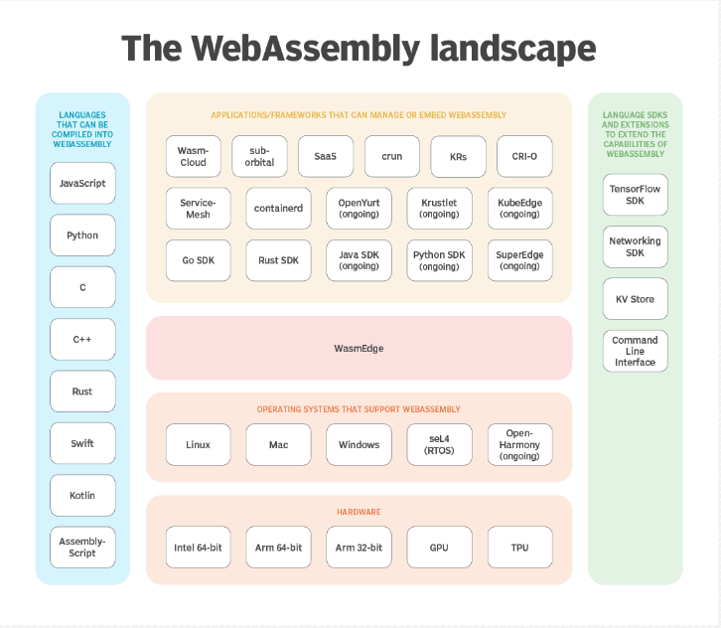

Slide 9
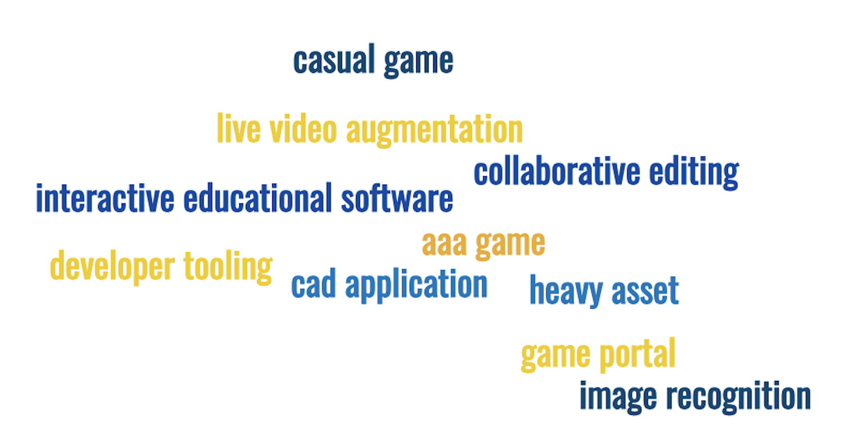
WASM Join Club When
Image/video editing
Games
Peer-to-peer applications
Music/Streaming
Image recognition
Live video augmentation
VR and augmented reality
CAD applications
Interactive educational software, and news articles
Platform simulation/emulation
Language interpreters and virtual machines
POSIX user-space environment (Kinda remote workstation)
Developer tooling (editors, compilers, debuggers)

Slide 10
01
Demo
Frontend
WASM

Slide 11
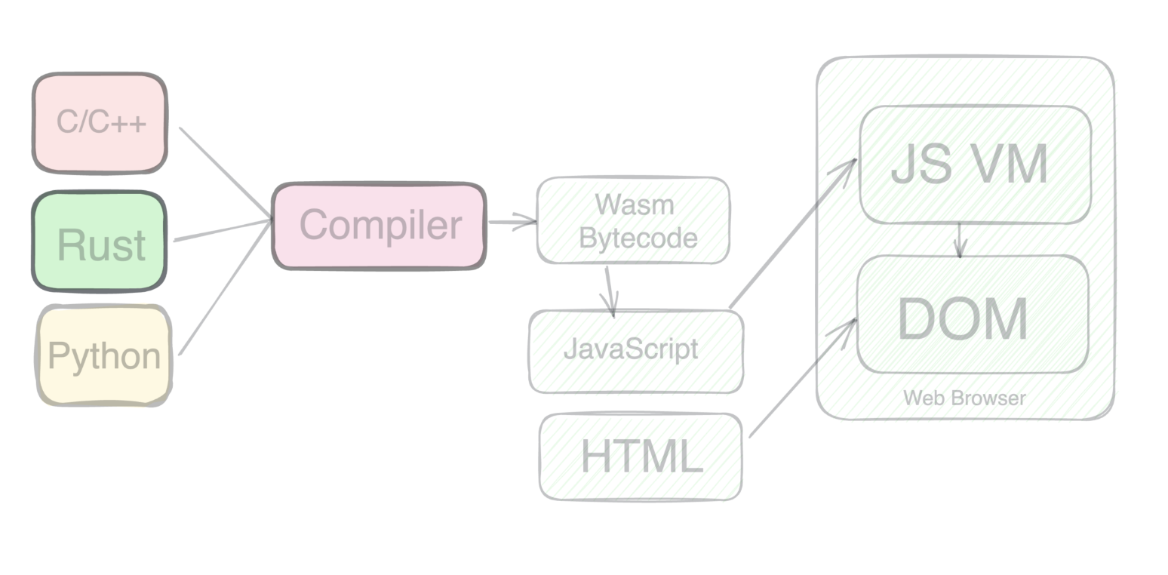
Get better idea

Slide 12
02
Demo
WASM in Web

Slide 13
Google uses WASM ?
Tensorflow backend
Earth
Photos
Meet
Sheet

Slide 14
WASM Outside Browser
WASM on apps
Using WASI - WebAssembly System Interface
VM/Machine/Localhost
Containers
Kubernetes
Serverless
Android, Flutter, React-Native, IOS

Slide 15



Will WASM replace Container ?

Slide 16

WASM & Docker Better together
A match made in tech haven
Remember sheer variety of use cases, Mean Docker is great for some applications & WASM for others
Docker excels at building/deploying cross-platform Cloud apps,
WASM well-suited to portable binary code for browser based apps
Virtual Machines (heavyweight class)
Containers (middleweight class)
Best for apps need heavy file system control & IO
WASM (lightweight class)
Best for fuss-free web server setup

Slide 17
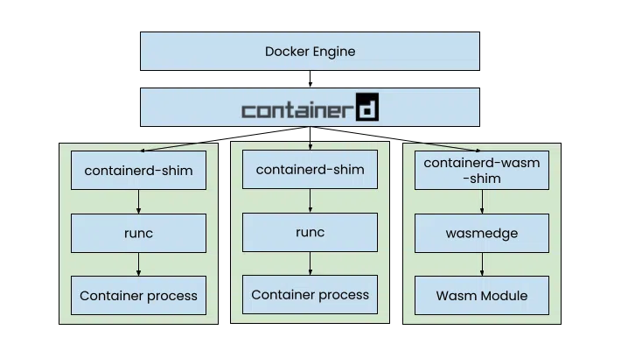
How Docker Integrate WASM ?

Slide 18
Docker Flags
--runtime=io.containerd.wasmedge.v1 – Informs the Docker engine that we want to use the Wasm containerd shim instead of the standard Linux container runtime
--platform=wasi/wasm32 – Specifies the architecture of the image we want to use. By leveraging a Wasm architecture, we don’t need to build separate images for the different architectures.

Slide 19



Thank you!
Find me on :
LinkedIn - Harsh Manvar
Twitter - manvar_harsh
Medium - harsh.manvar111
GitHub - harsh4870

